Slide 1
Welcome to A project Job Portal
Welcome to A project Job Portal
Submitted to:
Md. Morshahidul
Islam
Consultant Show and tell
Submitted by:
Dil Nazmin
Id:1244810

Slide 3


Slide 4
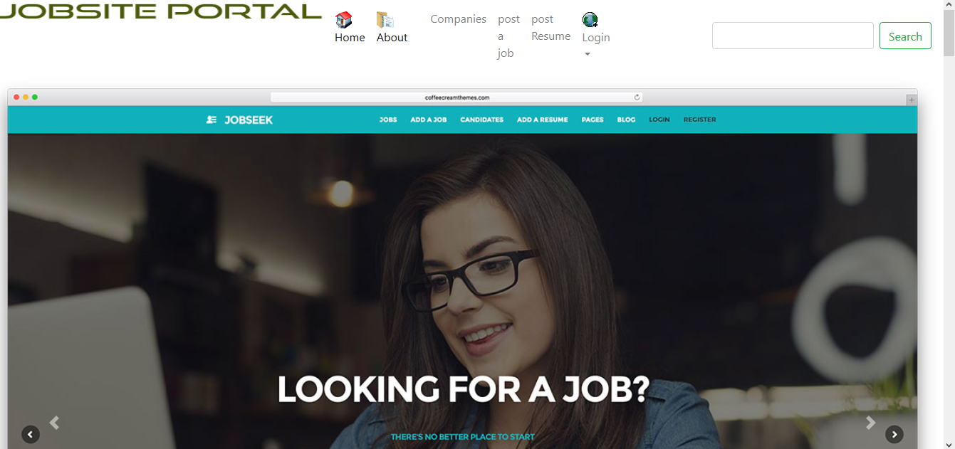

Slide 5
JOB Portal
A job portal, also known as a career portal,
is a modern name for an online job board that helps applicants find jobs
and aids employers in their quest to locate ideal candidates. Career websites,
such as Monster, Indeed and SimplyHired, have job portals that offer a broad
range of jobs in a vast number of fields. Some government agencies, nonprofit
organizations, universities and private businesses have their own job
portals that applicants can access on the organization's website.
job portals allow job seekers to connect with any recruiter irrespective of the geographicaldistances and vice versa for the recruiter. Job search portals make job searching time-efficient, easy and convenient. It helps to narrow down your search by eliminating the irrelevant job openings from the list.

Slide 6
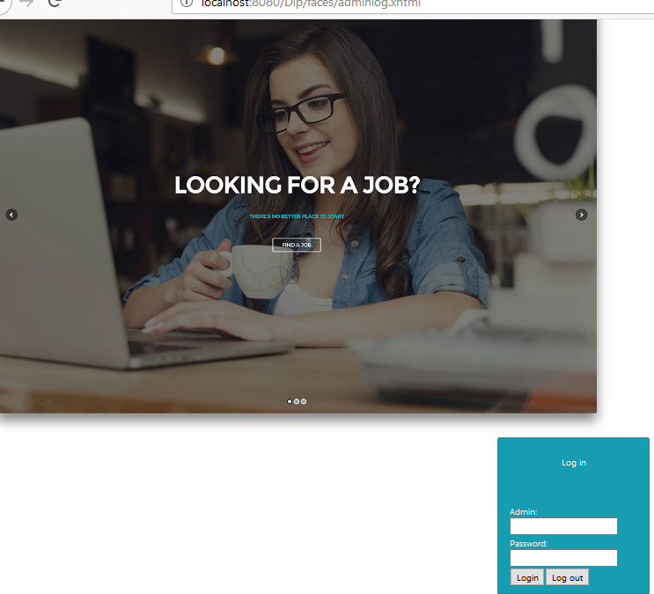
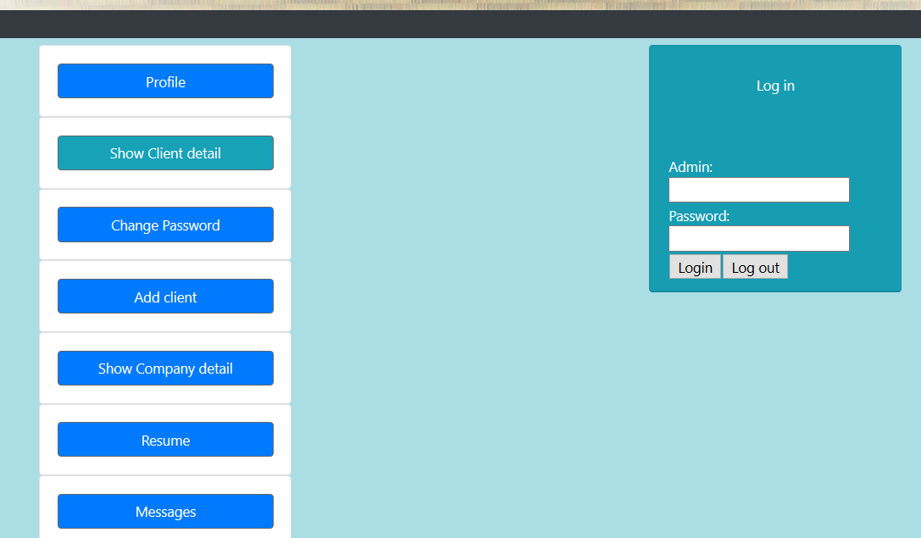
Admin page

Slide 7
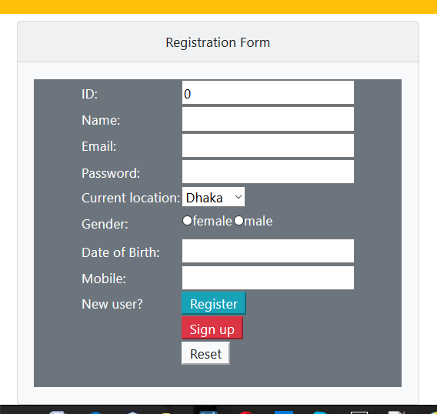
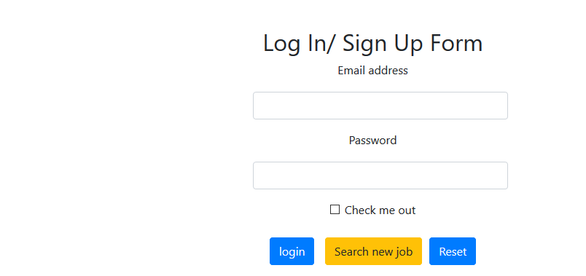
Login/sign up Form and Registration form

Slide 8
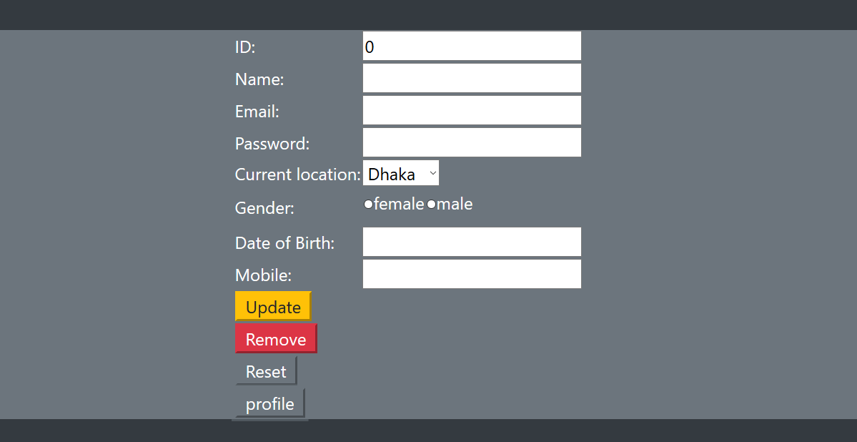
Registration Form

Slide 9
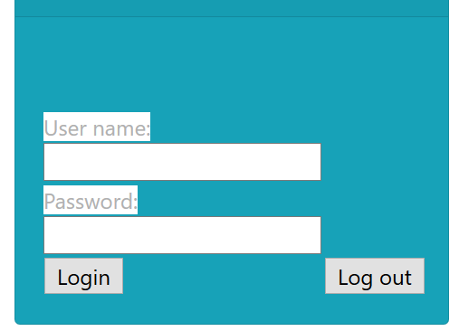
User login

Slide 10

User login page

Slide 11
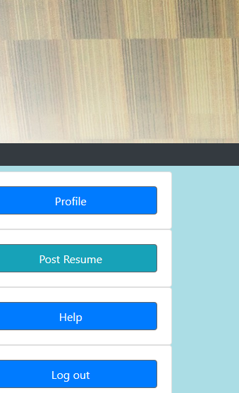
User profile

Slide 12
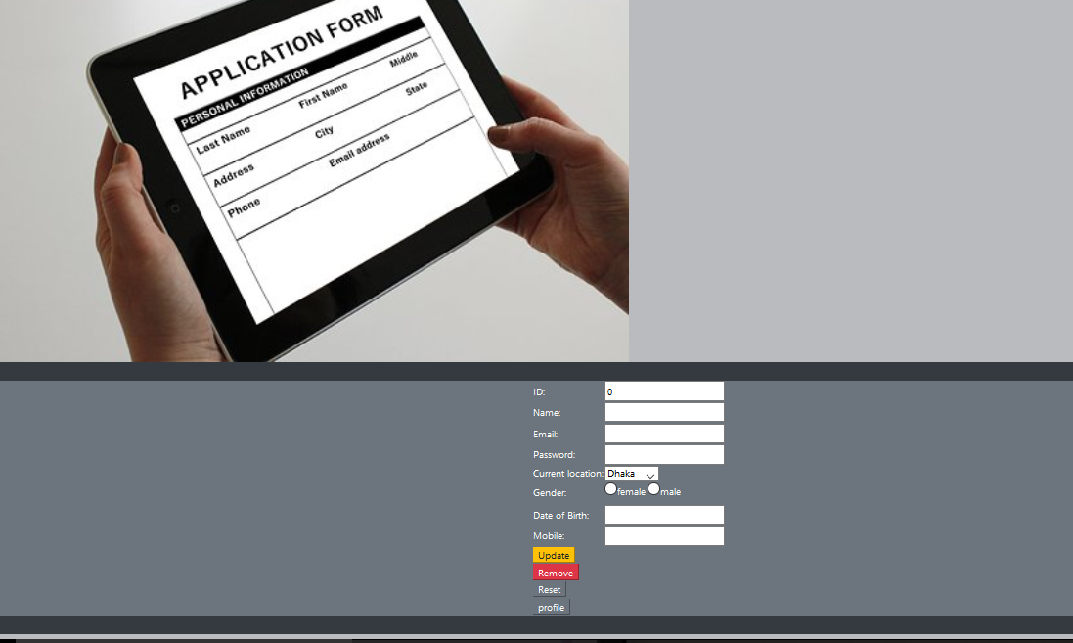

Slide 13

User’s change page

Slide 14
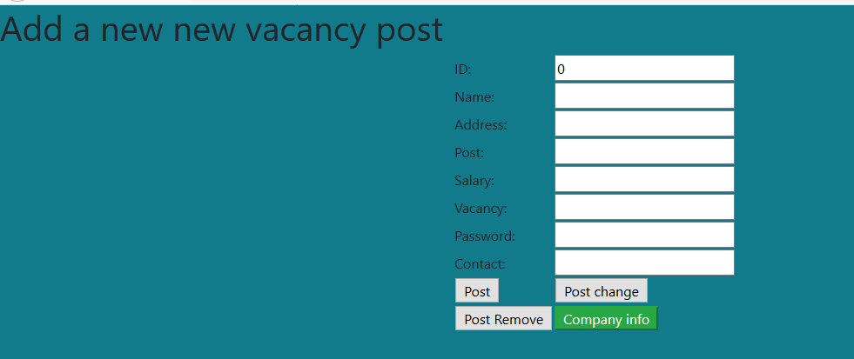

Slide 15
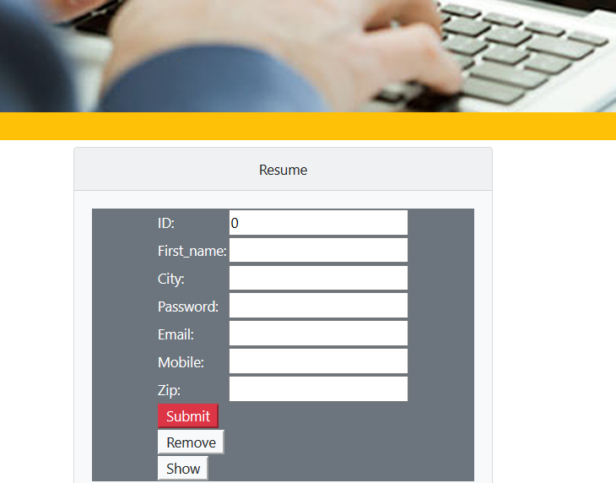
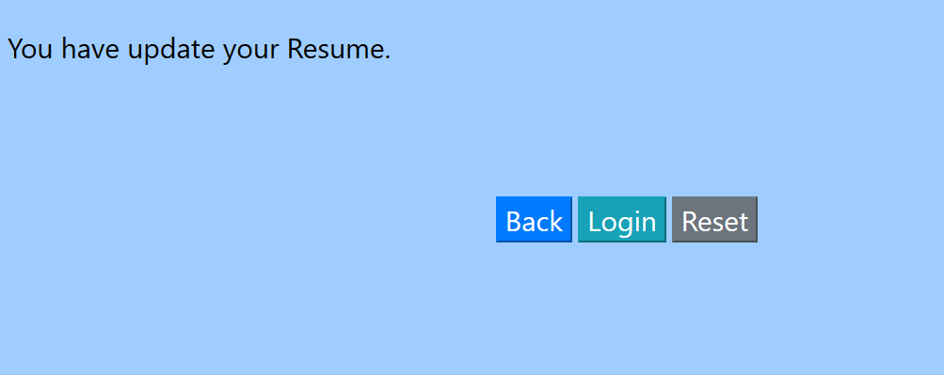
Post a job resume and success message

Slide 16


Slide 17
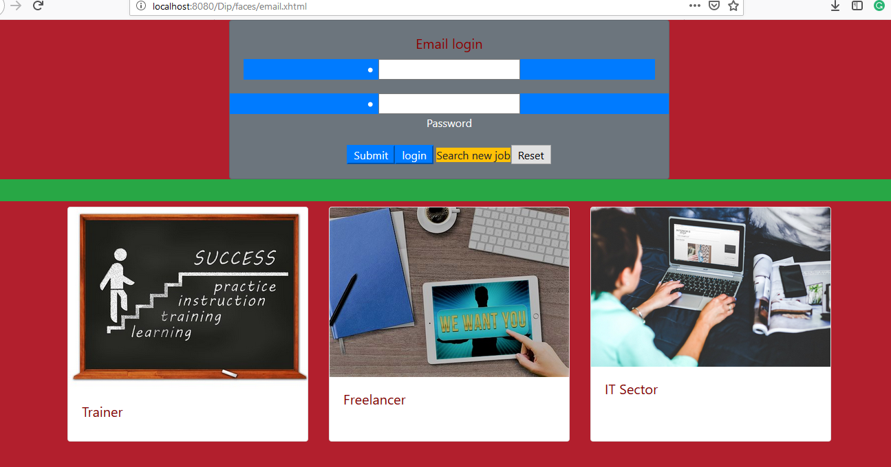
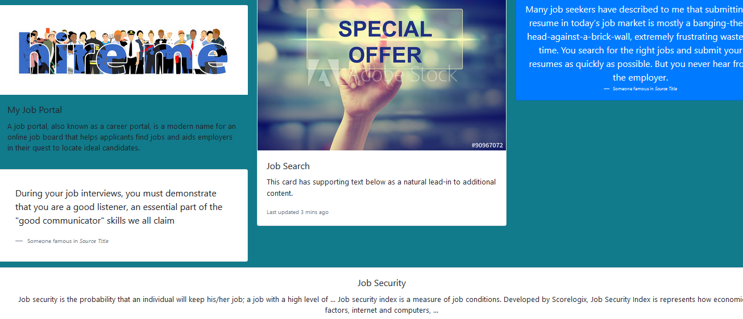


Slide 18
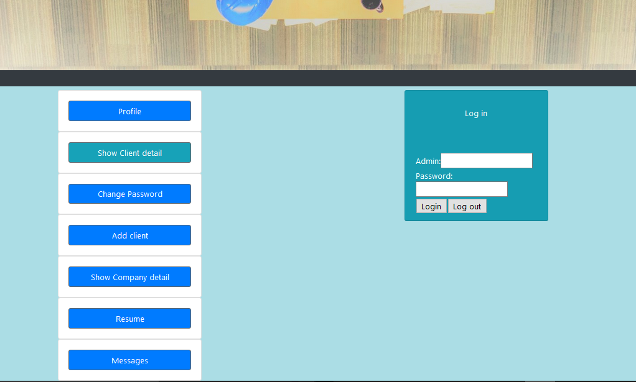

Slide 19


Slide 20
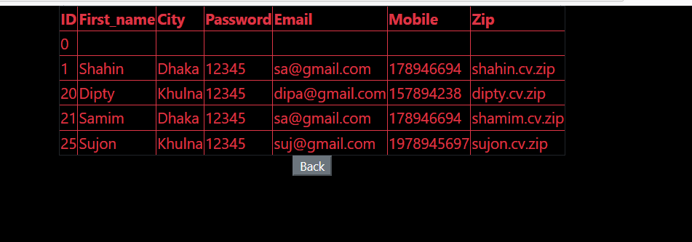
Customer ‘s cv

Slide 21
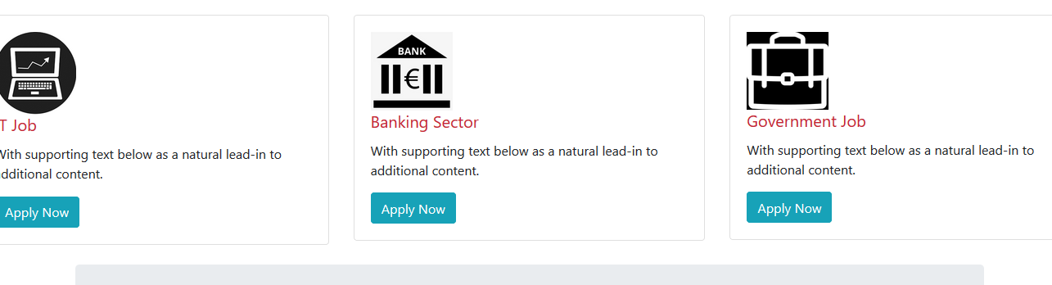

Slide 22


Slide 23


Slide 25
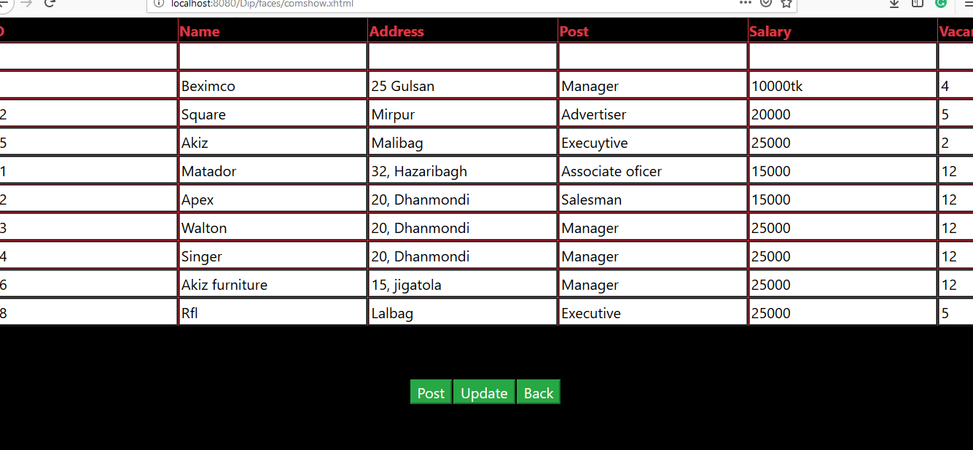

Slide 26
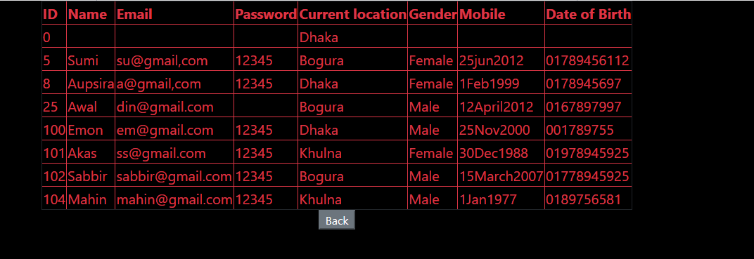
Client Detail

Slide 27
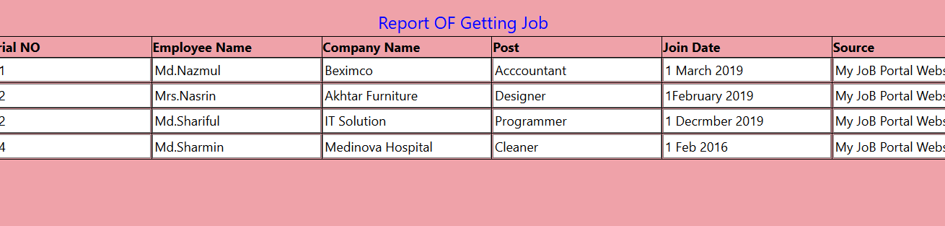

Slide 28
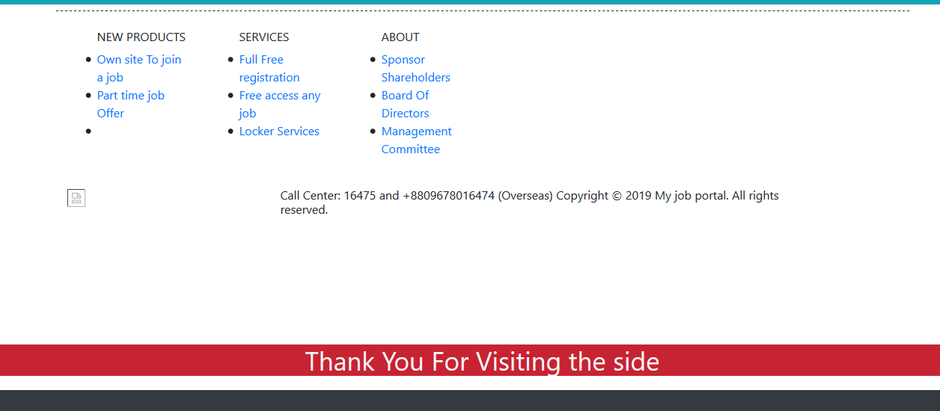

Slide 29
Future Development :
*Improve the System of collection cv
*Shows cv
*Detect selfdependent work
*increase more facility
*add an exra incoming source for user
*plays a vital remove to unemployment

Slide 30
Use component :
Jsp and hibernate
Prime faces
Class teacher and class mate help and
Instruction.
Google and youtube research.

Slide 31
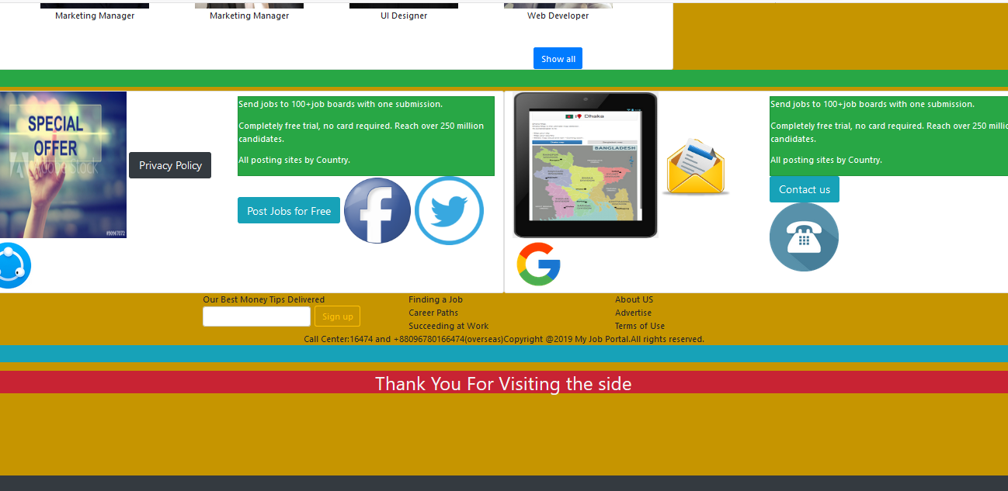

Slide 32
Thank You Allah
Thanks who have seen the project
For Your passion…

